Slide 1
Chapter 6 ARP and RARP
ARP
ARP package
RARP
Notes:
对应教材第4版的第8章

Slide 2
Addresses
Host identifier
IP address
Physical address
Network
Map
Data Link
Physical

Slide 3
Issues
A
C
E
B
D
A送往E的分组需封装在Ethernet帧中传送
IP地址：全局性
物理地址：本地性
A仅知道：IP_{A}，MAC_{A}，IP_{E}
Ethernet Frame：
？
目的MAC
源MAC
MAC_{A}
类型
IP Packet
FCS

Slide 4
Address Mapping（地址映射）
Logical address ←→ Physical address
Static Table
Logical address | Physical address
…… | ……
…… | ……
Static mapping
Consider:
NIC changed
Mobile computer
Dynamic mapping
Cache Table
Logical address | Physical address
…… | ……
…… | ……
Look for the target on demanding, using dynamic address resolution protocol

Slide 5
ARP and RARP
Logical address
Logical address
ARP
RARP
Physical address
Physical address
Notes:
动态映射的协议有2个，ARP和RARP

Slide 6
6.1 ARP
Address Resolution Protocol，RFC 826
地址解析协议：IP address → MAC address
Application Layer
Transport Layer
Network
Layer
ICMP
IGMP
IP
ARP
RARP
Network
Access
Layer
LANs
MANs
WANs

Slide 7
6.1.1 ARP Operation
I’m looking for the physical address of a node whose IP address is: 1.2.3.5
I am the node you are looking for, and my physical address is: 0005.5D06.1418
Request
Broadcast
Unicast
Reply
Request
Request
Request
A: 1.2.3.1
E: 1.2.3.5
B: 1.2.3.2
C: 1.2.3.3
D: 1.2.3.4
A’s ARP Cache：
IP address | MAC address
1.2.3.5
0005.5D06.1418
bind

Slide 8
用户输入命令“ftp 主机名”时的操作
主机名
主机名
目的
解析器
（1）
FTP
FTP
IP地址
（2）
TCP
TCP
（3）
（4）
IP
IP
ARP
ARP
ARP
（5）
（7）
（6）
以太网
驱动程序
以太网
驱动程序
以太网
驱动程序

Slide 9
IP Packet and ARP Packet
A
B
No binding
IP packet
ARP request
IP packet
IP packet
ARP reply
Binding A
IP
Binding B
IP
IP
IP packet
IP

Slide 10
ARP Process Cases
A
C
IP₁
MAC₁
IP₂
MAC₂
IP₃
MAC₃
IP₄
MAC₄
IP_{A}，MAC_{A}
IP_{C}，MAC_{C}
B
R1
R2
D
IP_{B}，MAC_{B}
IP_{D}，MAC_{D}
Case 1：A → B
In same IP network
Lab 2
Case 2：A → D
In different IP network

Slide 11
Case 1：A → B
sMAC=MAC_{A}，dMAC=MAC_{B}
sIP=IP_{A}，dIP=IP_{B}
dMAC=广播，Target_IP=IP_{B}
IP
sIP=IP_{A}，dIP=IP_{B}
A
C
ARP
request
IP
IP₁
MAC₁
IP₂
MAC₂
IP₃
MAC₃
IP₄
MAC₄
IP_{A}，MAC_{A}
IP_{C}，MAC_{C}
ARP
request
ARP
request
ARP
request
ARP
reply
R1
R2
D
B
IP_{B}，MAC_{B}
IP_{D}，MAC_{D}
IP Address | MAC Address
A’s ARP Cache：
IP_{B}
MAC_{B}
B’s ARP Cache：
IP_{A}
MAC_{A}
R1’s ARP Cache：

Slide 12
Case 2：A → D
sMAC=MAC₂，dMAC=MAC₃
sIP=IP_{A}，dIP=IP_{D}
IP_{D}不在本网内，分组由R1转发
sMAC=MAC₄，dMAC=MAC_{D}
sIP=IP_{A}，dIP=IP_{D}
sMAC=MAC_{A}，dMAC=MAC₁
sIP=IP_{A}，dIP=IP_{D}
dMAC=广播，Target_IP=IP₁
IP
sIP=IP_{A}，dIP=IP_{D}
A
C
ARP
request
IP
IP₁
MAC₁
IP₂
MAC₂
IP₃
MAC₃
IP₄
MAC₄
IP_{A}，MAC_{A}
IP_{C}，MAC_{C}
ARP
request
ARP
request
ARP
reply
ARP
request
R1
R2
D
B
IP₁是A的缺省网关（Default Gateway）
IP_{B}，MAC_{B}
IP_{D}，MAC_{D}
IP Address | MAC Address
A’s ARP Cache：
IP₁
MAC₁
B’s ARP Cache：
R1’s ARP Cache：
IP_{A}
MAC_{A}

Slide 13
6.1.2 ARP Packet
Hardware Type |  | Protocol Type
Hardware address len | Protocol address len | Operation Request 1, Reply 2
Sender hardware address （For example，6 bytes for Ethernet）
Sender protocol address （For example，4 bytes for IP）
Target hardware address （For example，6 bytes for Ethernet）
Target protocol address （For example，4 bytes for IP）
It is not filled in a request
Notes:
十

Slide 14
Encapsulation of ARP packet
The byte order of ARP packet
Example：Ethernet frame
byte
2
2
1
1
2
6
4
6
4
HType | PType | HL | PL | OP | sMAC | sIP | tMAC | tIP
byte
6
6
2
46 ~ 1500
46
4
ARP Packet
Packet
目的MAC
源MAC
0x0806
pad
类型
FCS
28 bytes

Slide 15
Example
A host with IP address 130.23.43.20 and physical address 0xB23455102210 has a packet to send to another host with IP address 130.23.43.25 and physical address 0xA46EF45983AB. The two hosts are on the same Ethernet network. Show the ARP request and reply packets encapsulated in Ethernet frames.

Slide 16
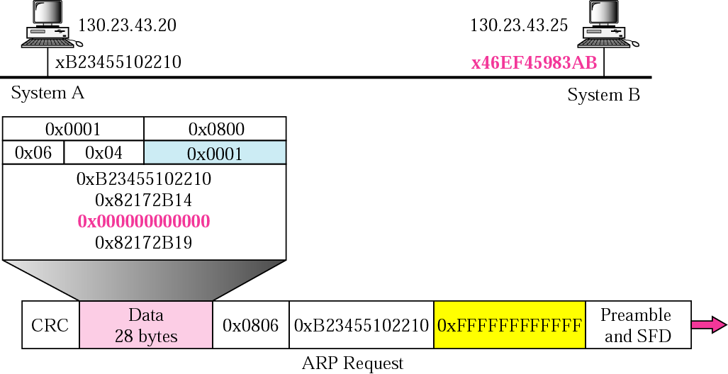
Example: ARP Request

Slide 17
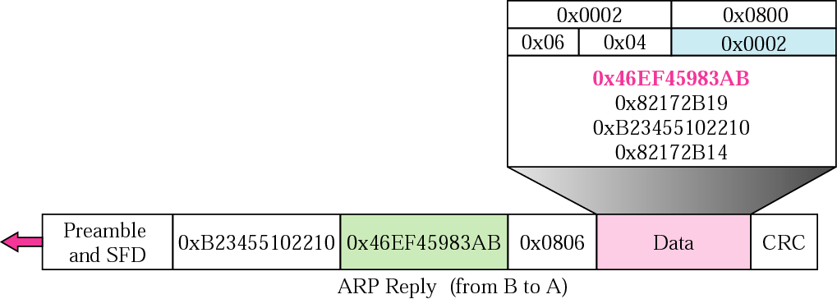
Example: ARP Reply

Slide 18
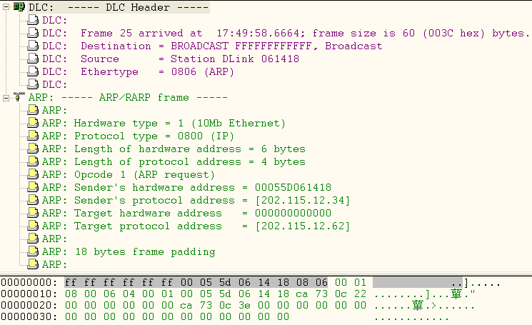
Example: ARP Request Packet

Slide 19
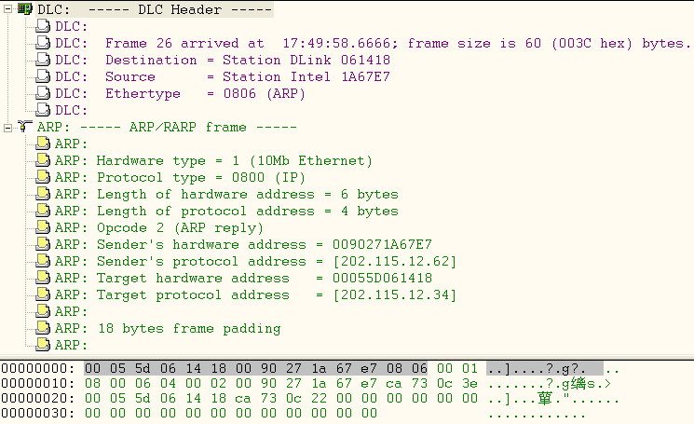
Example: ARP Reply Packet

Slide 20
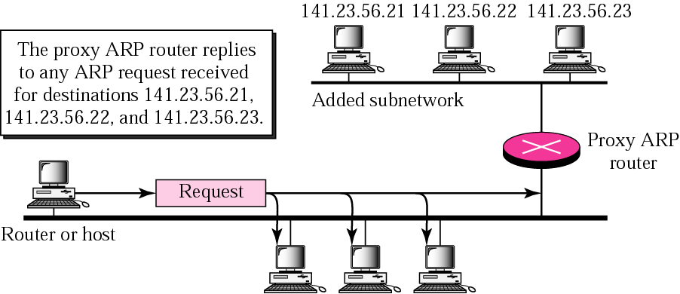
6.1.3 Proxy ARP
“Honest”
Hided
Q: In the same IP network or not?
Notes:
代理ARP

Slide 21
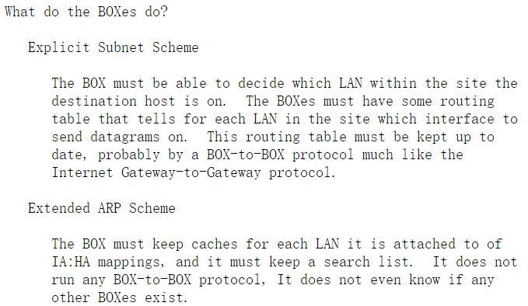
Answer
RFC 925: Multi-LAN Address Resolution
Explicit subnets
Transparent subnets（Extended ARP）
Notes:
显式子网 透明子网 RFC925: The new element is the "magic box" ("ARP-based bridge") that relays the ARP request into neighboring LANs and acts as an agent for relaying datagrams to hosts on other LANs. The host must be able to decide if this IA is on this LAN or some other LAN. If on this LAN then use some procedure to find the HA. If on some other LAN then use some procedure to find the HA of a BOX.

Slide 22
Answer
RFC 1027: Using ARP to Implement Transparent Subnet Gateways
Routers: Explicit subnets
Hosts: Transparent subnets
“ From the host point of view, there are no subnets, and their physical networks are simply one big IP network. ”
Notes:
RFC-925 describes a general mechanism for dynamic subnet routing using Proxy ARP and routing caches in the gateways. Our technique is restricted subset of RFC-925, in which we use static subnet routes which are determined administratively. As a result, our transparent subnet gateways require no new network routing table entries nor ARP cache entries; the only tables which are affected are the ARP caches in the host

Slide 23
RFC 1027 Discussion
.33
.34
.35
.1/27
R
.62/27
.3
.4
.5
Solution：
R代替.35向.3返回ARP应答
—— Proxy ARP
200.6.8.32/27
Hided network
200.6.8.0/24
Main network
.3向.35发送IP分组
.3广播请求.35的ARP分组，R不转发广播
.35向.3发送IP分组
.35广播请求.62的ARP分组
→ IP发送失败
→ ARP失败
→ IP发送成功
→ ARP成功
Notes:
In our implementation, routing loops are prevented by proper administration of the subnet routing tables in the gateways.

Slide 24
6.1.4 Gratuitous ARP
W. Stevens: 《TCP/IP Illustrated Volume 1: The Protocol》
Duplicate address test
A
202.115.12.34
2. ARP reply:
sIP = tIP = 202.115.12.34
1. ARP request: sIP = tIP = 202.115.12.34
202.115.12.34
B
3. Disable local interface: 202.115.12.34
Startup or
Change IP address
Notes:
免费/无故的 ARP，可以有两个方面的作用：1) 一个主机可以通过它来确定另一个主机是否设置了相同的I P地址；2) 如果发送免费ARP的主机正好改变了硬件地址（很可能是主机关机了，并换了一块接口卡，然后重新启动），那么这个分组就可以使其他主机高速缓存中旧的硬件地址进行相应的更新。

Slide 25
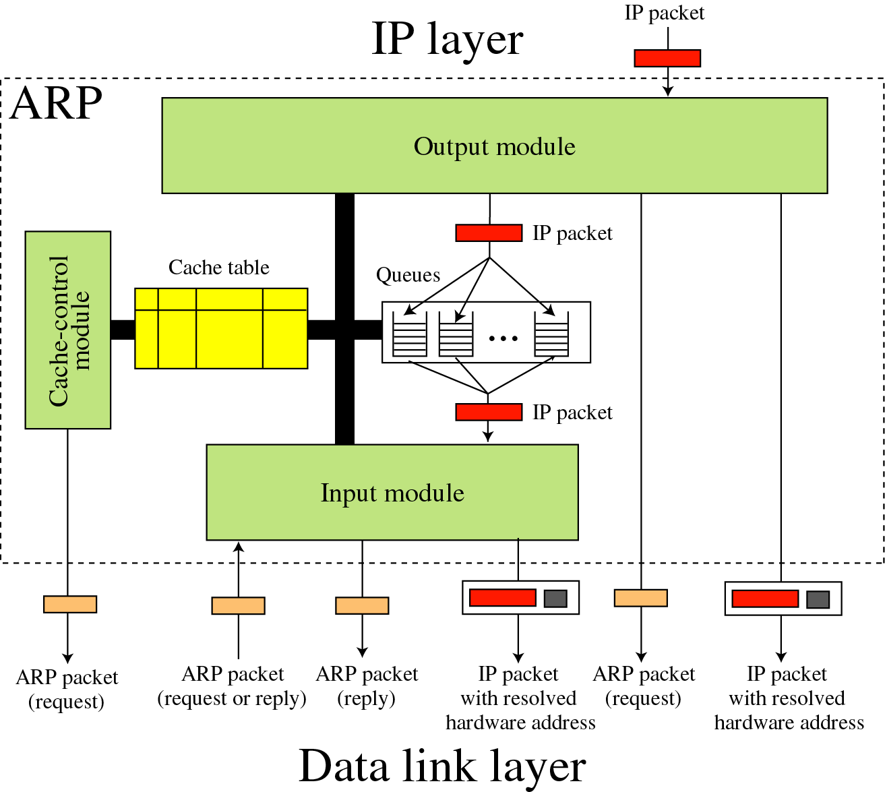
6.2 ARP Package
Notes:
由5个部分构成

Slide 26
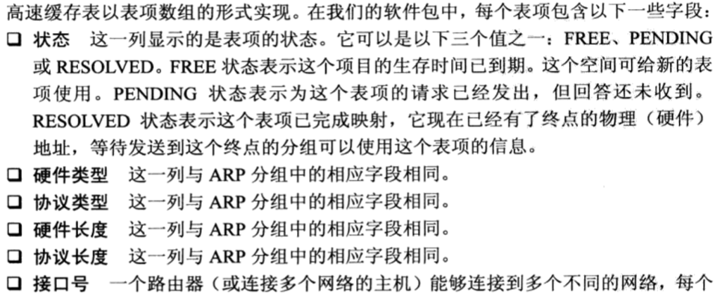
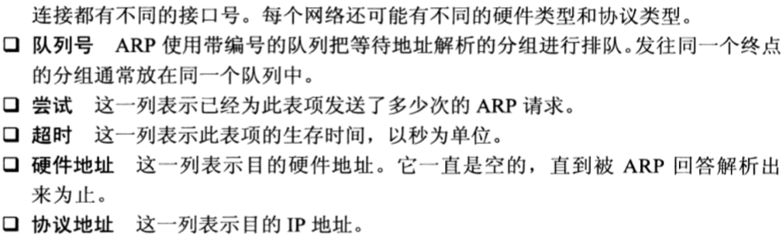
6.2 ARP Package
高速缓存表
Notes:
高速缓存表用于减少每一次数据报发送时的 ARP协议过程

Slide 27

6.2 ARP Package
队列
Notes:
未分配物理地址的分组

Slide 28
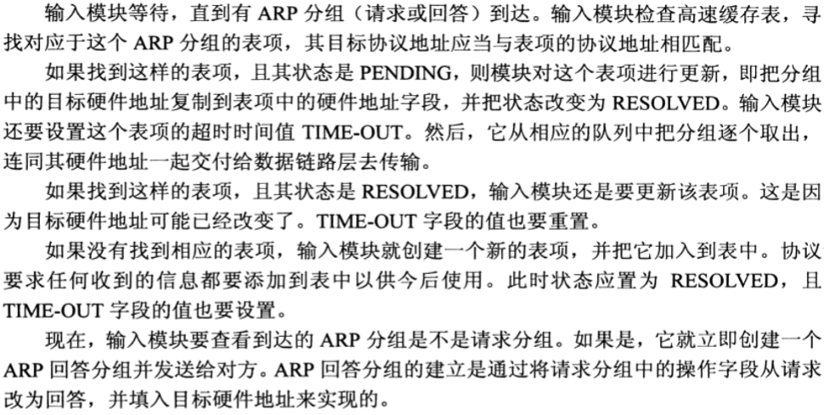
6.2 ARP Package
输入模块
Notes:
未分配物理地址的分组

Slide 29
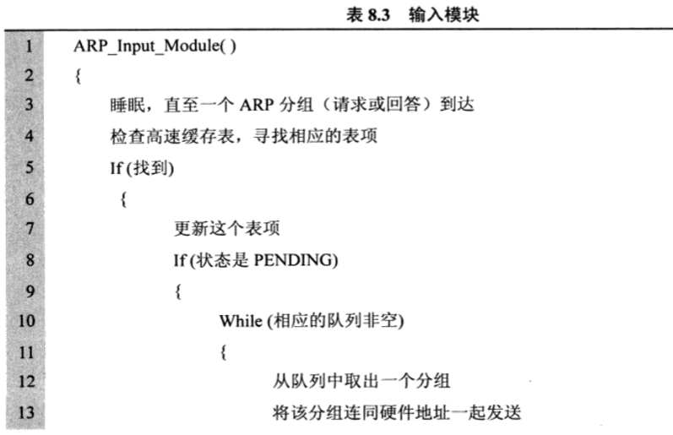
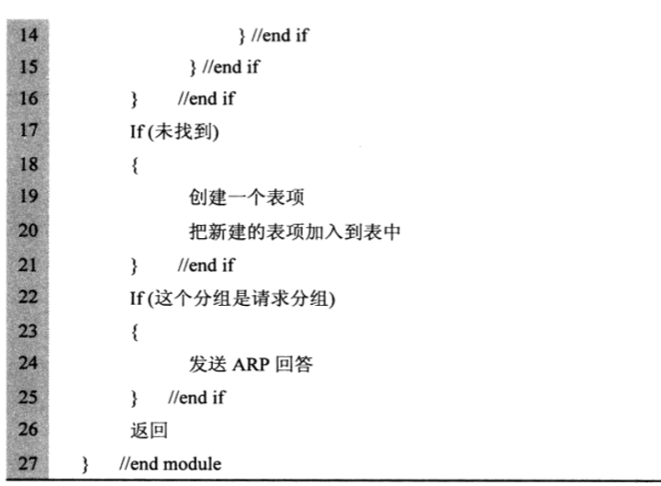
6.2 ARP Package
输入模块
Notes:
未分配物理地址的分组

Slide 30
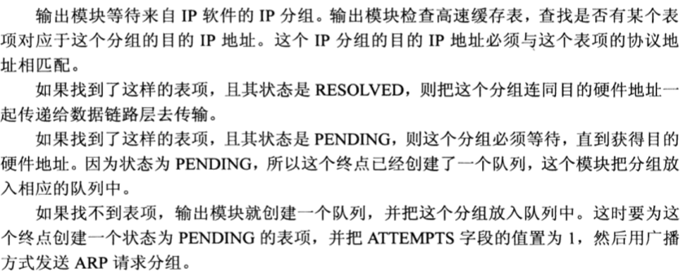
6.2 ARP Package
输出模块
Notes:
未分配物理地址的分组

Slide 31
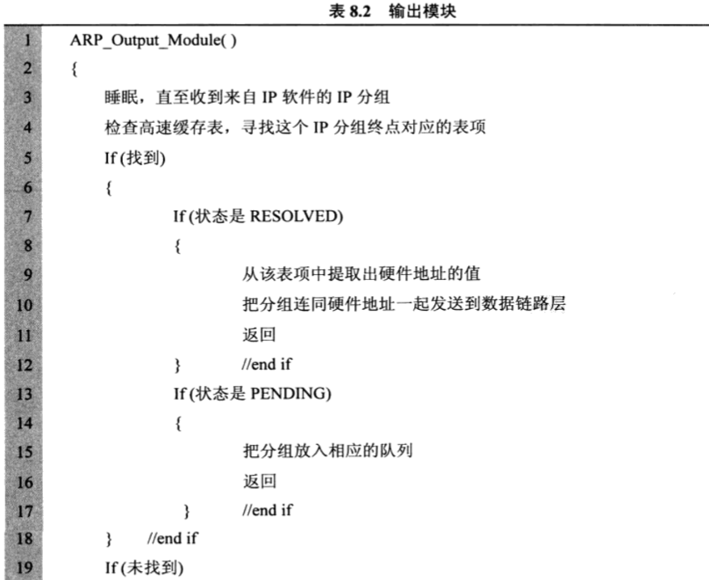
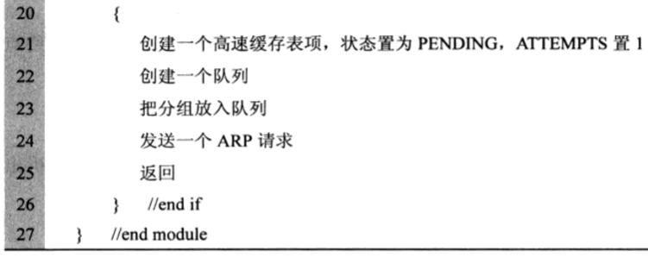
6.2 ARP Package
输出模块
Notes:
未分配物理地址的分组

Slide 32
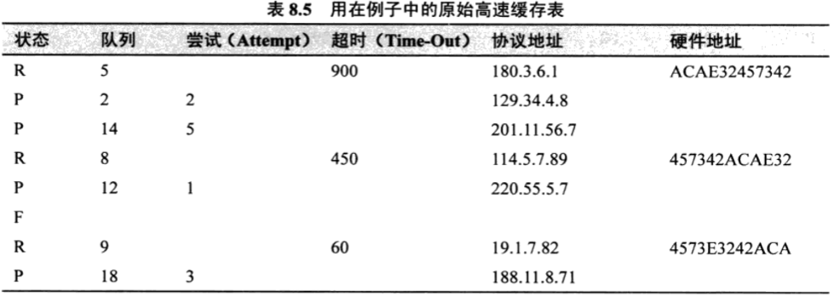
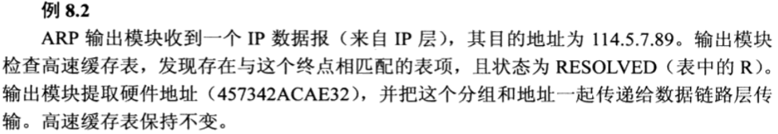
6.2 ARP Package
高速缓存表例子
Notes:
未分配物理地址的分组

Slide 33
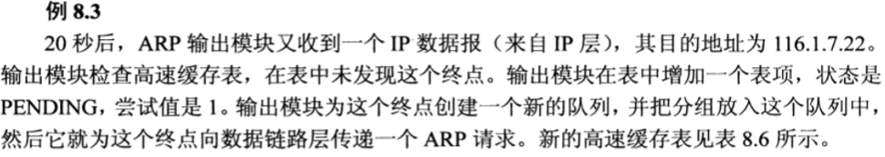
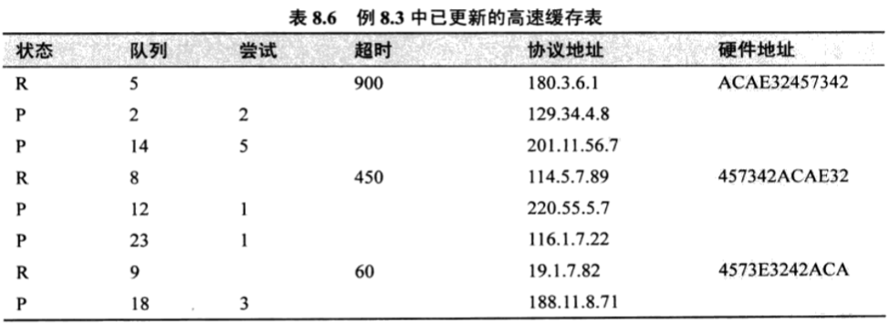
6.2 ARP Package
高速缓存表例子
Notes:
未分配物理地址的分组

Slide 34
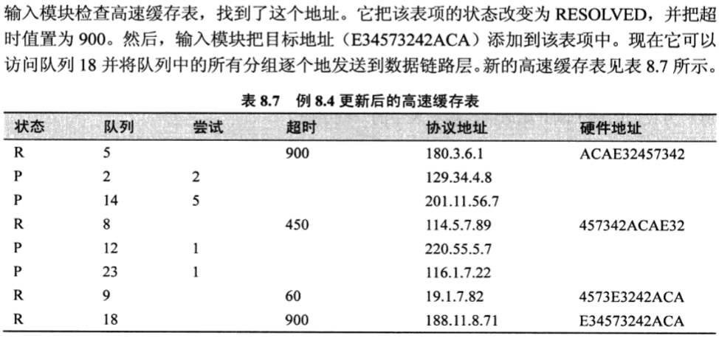
6.2 ARP Package
高速缓存表例子
Notes:
未分配物理地址的分组

Slide 35
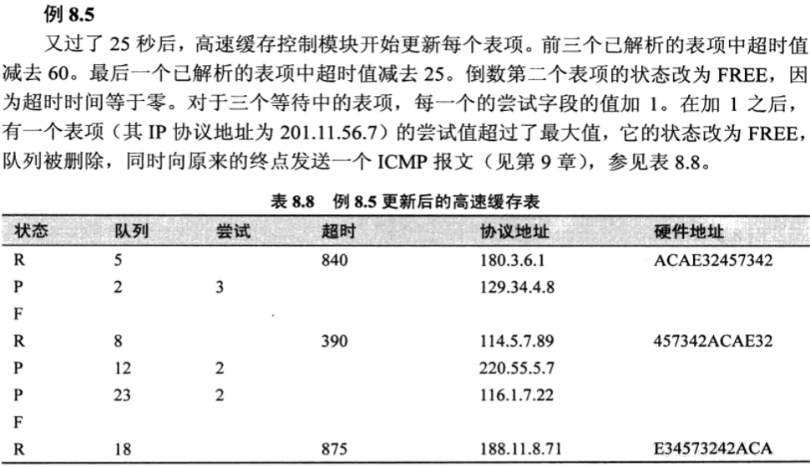
6.2 ARP Package
高速缓存表例子
Notes:
未分配物理地址的分组

Slide 36
ARP Cache
Host（Windows XP）
Router（Cisco）
C:\> arp –a
Interface: 202.115.12.34 --- 0x2
Internet Address Physical Address Type
202.115.12.33 00-90-27-a7-98-41 dynamic
202.115.12.47 00-90-27-1d-d9-94 dynamic
202.115.12.62 00-90-27-1a-67-e7 dynamic
Router# show arp
Protocol Address Age (min) Hardware Addr Type Interface
Internet 202.115.12.33 -- 0090.27a7.9841 ARPA Ethernet0
Internet 202.115.12.34 5 0005.5d06.1418 ARPA Ethernet0
Internet 202.115.13.1 -- 00e0.7bc0.b205 ARPA Ethernet1
Notes:
此处是ARP cache，前面是ARP软件包中的缓存表

Slide 37
Discussion
更新ARP绑定时，发现已有的绑定与新的绑定不一样，是保持已有的还是替换它？
封装IP报文的以太帧中的源MAC和IP报文中的源IP可否用于刷新ARP表项？目的MAC和目的IP呢？
教材第3版第150页中ARP输入模块描述有误
参见RFC 826中的Packet Reception一节
关键问题：用什么地址查ARP缓存？什么情况下创建新的ARP表项？

Slide 38
RFC References
RFC 1122: Requirements for Internet Hosts -- Communication Layers
Section 2.3.2: ARP cache, ARP packet queue
RFC 1812: Requirements for IPv4 Routers
Section 3.3.2
RFC 1433: Directed ARP
ARP helper address
RFC 1868: ARP Extension – UNARP
Announce leaving

Slide 39
6.3 RARP
Reverse Address Resolution Protocol
RFC 903：MAC地址 → IP地址
Application Layer
Transport Layer
Network
Layer
ICMP
IGMP
IP
ARP
RARP
Network
Access
Layer
LANs
MANs
WANs

Slide 40
RARP Operation
Purpose
无盘机器的引导、动态IP地址配置
Packet format
与ARP分组相同
Operation：3 – RARP request，4 – RARP reply
Ethernet frame encapsulation
类型：0x8035
Operation
RARP request：广播发送，sIP、tIP不填，sMAC = tMAC
RARP reply：仅由RARP服务器单播发送

Slide 41
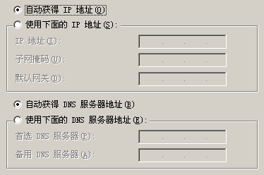
Alternative Solutions to RARP
RARP 只能获得IP地址
掩码
默认网关
DNS 服务器
DHCP
BOOTP

Slide 42
6.4 Summary
ARP
作用、分组格式
操作
何时发送、送给谁
发送方式（单播、广播）
发送内容（ARP分组各字段的具体取值，以及封装该分组的以太帧中各字段的具体取值）
Proxy ARP、Gratuitous ARP
RARP
作用、操作、缺陷

